Slide 1
Compiler
Second phase
Syntax analyzer (parsing) تفسير
use the first component of the tokens produced by the lexical analyzer to create a tree.

Slide 2
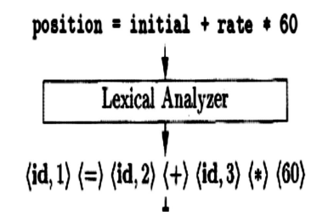
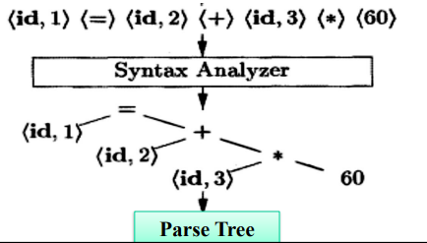
Compiler
Second phase
Syntax analyzer (parsing)

